Slide 1
Gradient of Diffusion
By Michelle Goodman
29/11/2016

Slide 2
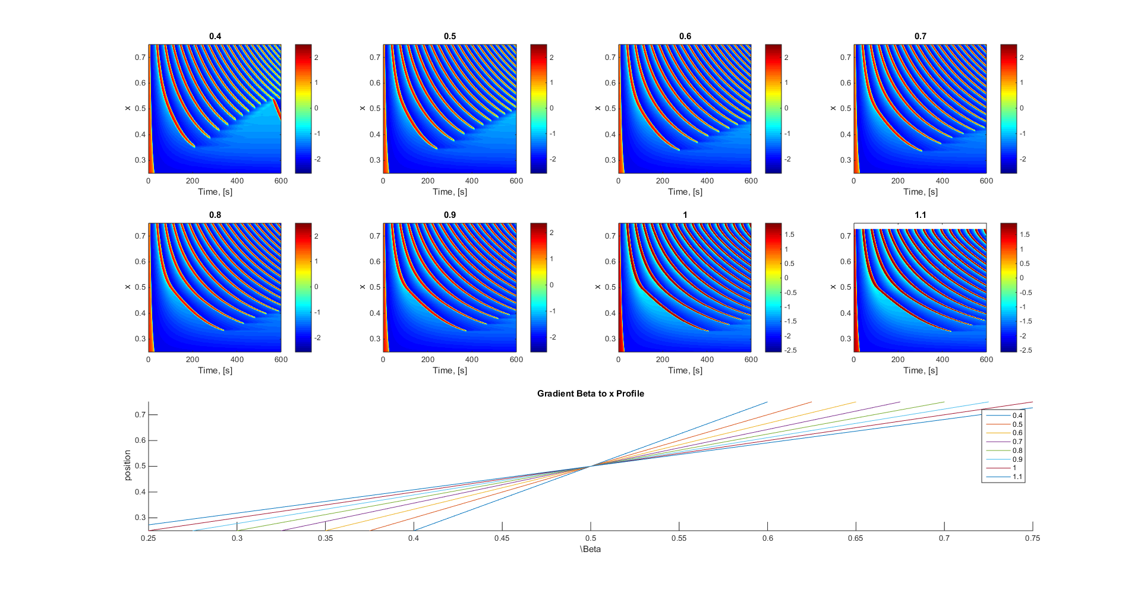
Different Diffusion Gradients

Slide 3
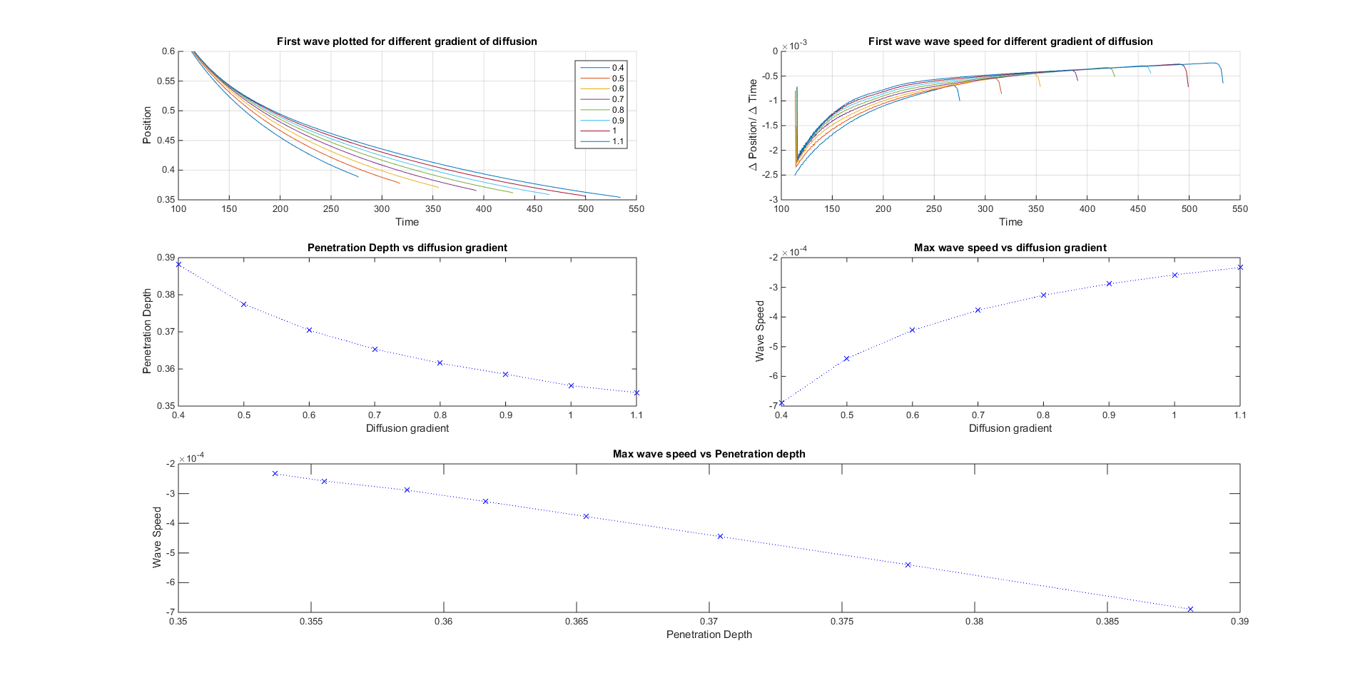
Penetration Depth

Slide 4
Wave Speed

Slide 5
Wave Speed vs depth

Slide 6
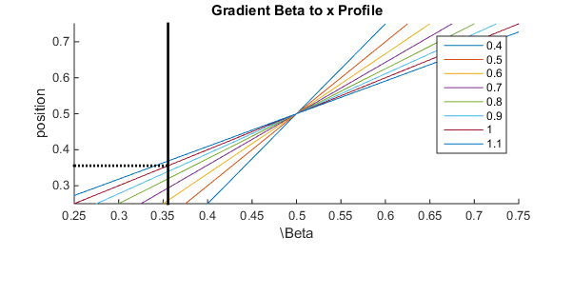
Corrected?

Slide 7



